Slide 1
Parts of an airplane

Slide 2
Control Surfaces are moveable surfaces on an airplane’s wings and tail that allow a pilot to maneuver an airplane and control its attitude or orientation. These control surfaces work to create a difference in air pressure to produce a force on the airplane in a desired direction. Using the same principle as how lift is generated by a planes wing (Bernoulli’s Principle).

Slide 3
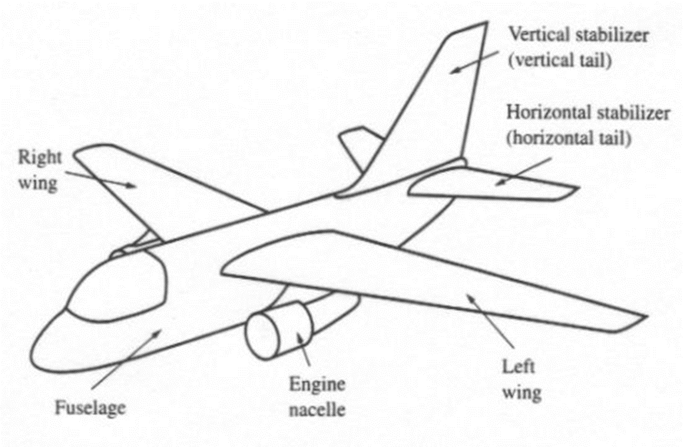
Basic Parts of an Airplane

Slide 4
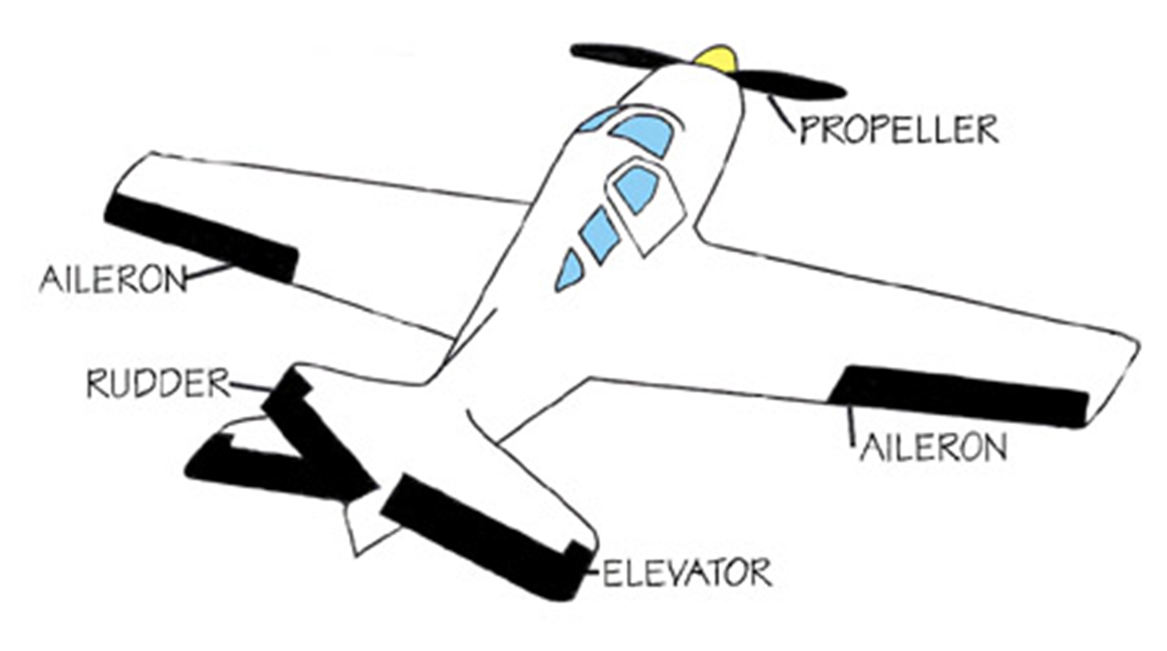
Control Surfaces on an Airplane
The specific parts that control how the plane flies.

Slide 5
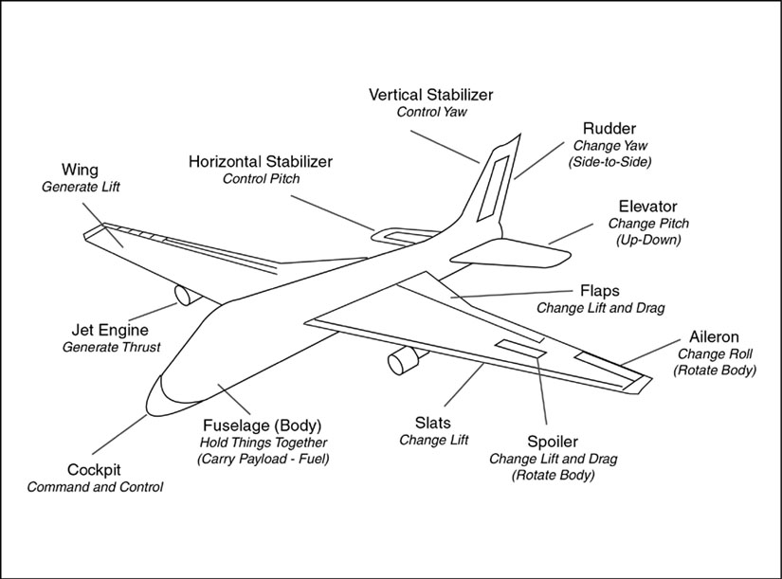
All Parts Of An Airplane

Slide 6
Airplane Rear Wings…
This horizontal stabilizer helps keep the airplane aligned with its direction of motion. If the airplane tilts up or down, air pressure increases on one side of the stabilizer and decreases on the other, pushing it back to its original position.
The stabilizer also holds the tail down, countering the tendency of the nose to tilt downward — a result of the airplane’s center of gravity being forward of the wing’s center of lift.

Slide 7
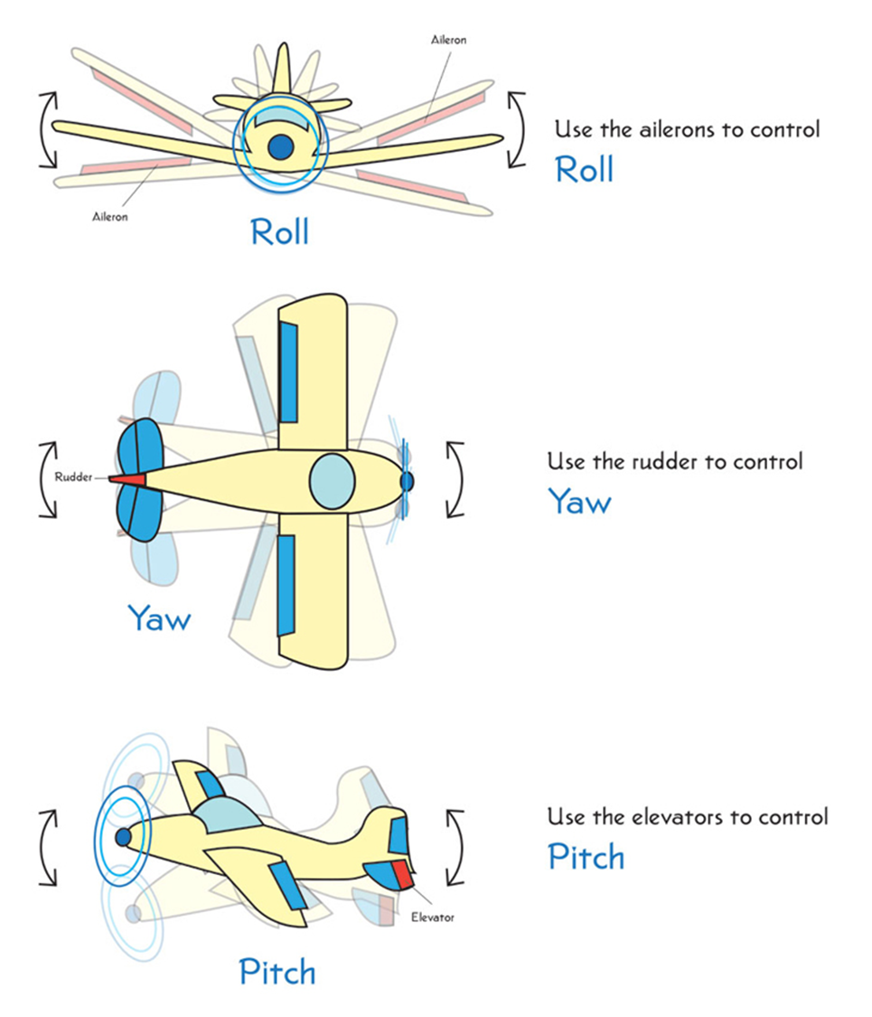
Roll
Yaw
Pitch

Slide 8
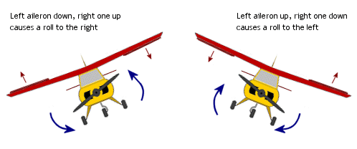
Ailerons Control the Roll
Ailerons Controls Roll…On the outer rear edge of each wing, the two ailerons move in opposite directions, up and down, decreasing lift on one wing while increasing it on the other. This causes the airplane to roll to the left or to the right. To turn the airplane, the pilot uses the ailerons to tilt the wings in the desired direction.

Slide 9
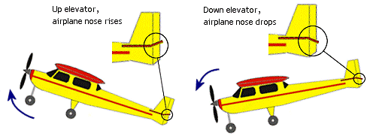
Elevators Control the Pitch
The Elevator Controls Pitch… On the horizontal tail surface, the elevator tilts up or down, decreasing or increasing lift on the tail. This tilts the nose of the airplane up and down.

Slide 10
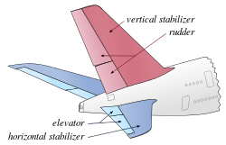
An Airplane’s Tail: Maintaining Stability…
The main purpose of the tail is to provide stability. If tilted by a gust of wind, a stable airplane tends to recover, just as a ball lying at the bottom of a bowl will roll back to the center after being disturbed.
What does a plane’s “Tail Fin” do?
A vertical stabilizer, or tail fin, keeps the airplane lined up with its direction of motion. Air presses against both its surfaces with equal force when the airplane is moving straight ahead. But if the airplane pivots to the right or left, air pressure increases on one side of the stabilizer and decreases on the other. This imbalance in pressure pushes the tail back into line.

Slide 11
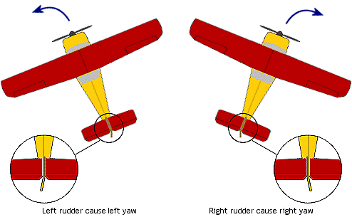
The Rudder Controls the Yaw
The Rudder Controls Yaw… On the vertical tail fin, the rudder swivels from side to side, pushing the tail in a left or right direction. A pilot usually uses the rudder along with the ailerons to turn the airplane.

Slide 12
Roll, Pitch and Yaw

Slide 13
Propellers
There are two ways an aircraft can get thrust: A jet engine or PROPELLERS.
Propellers are twisted wings that spin like powerful household fans. Propellers are shaped like airfoils which creates high air pressure and low air pressure areas which causes lift. These propellers cause a lift the moves the aircraft up and down instead of titling wings like on an airplane.
Propellers used on planes usually have six long thin blades attached to an engine. They push air backwards forcing the airplane to move forwards causing the wings to cut into the air CREATING LIFT!
A Jet Engine gets thrust by burning fuel. The fuel mixes with oxygen from the air and lights up a spot in the engine. The exhaust gases are forced backwards really fast which pushes the plane forward.

Slide 14
Great Flight YouTube Videos
How to Fly an Aircraft: Exterior Parts of an Aircraft
http://www.youtube.com/watch?v=alTshKL0k6Y
How to Fly an Aircraft: Changing the Pitch
http://www.youtube.com/watch?v=I_Hgckch-oA
How to Fly an Aircraft: Roll Movement in an Aircraft
http://www.youtube.com/watch?v=VYSXWy7nzY0&NR=1&feature=fvwp
How to Fly an Aircraft: Yaw movement in an Aircraft
http://www.youtube.com/watch?v=6Ddwm4_CaYE&NR=1

